Slide 1

Force and Vehicle Safety
Dakota Drazic Task 11

Slide 2
Principle A
Crumple zones are places on a car that are made to crush in an accident in a controlled fashion. They lengthen the amount of time it takes for the driver and passengers' momentum to alter during a collision, which lessens the force applied.
Slowing down the deceleration is the greatest approach to lessen the initial force in a crash with a given amount of mass and speed. If you've ever had to slam on the brakes for any reason, you've experienced this effect firsthand. Compared to when you gradually slow down at a stoplight, the forces you encounter during an emergency stop are far stronger. A collision's force can be significantly reduced by reducing the deceleration by merely a few tenths of a second.

Slide 3
Principle B
Intense kinetic forces are at play whenever an automobile is in a collision. Any crash involves a certain amount of force. The precise figures change depending on the vehicle's speed, mass, and the object it strikes. Even when travelling from a high speed to a low speed, any change in speed over time is technically referred to as acceleration. Physicists measure this force as acceleration. We will refer to collision acceleration as deceleration to avoid ambiguity.

Slide 4
Principle B pg. 2
A lower centre of gravity will provide better handling. By lowering your suspension, you're also lowering wind resistance and the car's centre of gravity. This translates into you being able to drive your car faster. Reduced rollover risk.
A vital factor in determining a vehicle's stability, braking effectiveness, and safety is its centre of gravity (CG). As the only source of propulsion in a gravity vehicle, mass has a significant role in how well the vehicle performs.

Slide 5
Principle C
In the event of an accident, seat belts prevent you from tossing around within the vehicle. The seat belts lock into position when they detect a collision. According to Newton's First Law, the individual is not subject to an imbalanced force when the car crashes, therefore they continue moving ahead. A force is applied to the seat belt as the individual moves against it.

Slide 6
Principle D
Seat belts and inertia are related concepts. In a moving car, inertia is felt. Cars have seat belts to mitigate the effects of inertia. You will fly forwards into the dashboard if a car on a highway moving at 55 mph collides with another vehicle.

Slide 7

Mercedes Benz B-Class 2016 safety features
Anti-lock brakes
ABS brakes automatically sense when a tire has stopped rotating under extreme braking, and will modulate the brake pressure to allow the tire to rotate. This increases the vehicles ability to turn while braking.
Stability control
Stability control automatically senses when the vehicles handling limits have been exceeded and reduces engine power and/or applies select brakes to help prevent the driver from losing control of the vehicle.
Front-impact airbags
Front-impact airbags for the driver and passenger have been designed to protect the head during a frontal crash.
Side impact airbags
Side impact airbags for the front seats have been designed to protect the torso during a side impact collision.
Overhead airbags
Overhead airbags are used to protect the occupant's heads in the event of a side collision or rollover.

Slide 8

Classify each feature as either A, B, C, D according to the principle/s it is employing
Anti-lock brakes
ABS brakes automatically sense when a tire has stopped rotating under extreme braking, and will modulate the brake pressure to allow the tire to rotate. This increases the vehicles ability to turn while braking. (principle A)
Stability control
Stability control automatically senses when the vehicles handling limits have been exceeded and reduces engine power and/or applies select brakes to help prevent the driver from losing control of the vehicle. (principle B- 2ND PART)
Front-impact airbags
Front-impact airbags for the driver and passenger have been designed to protect the head during a frontal crash. (principle C)
Side impact airbags
Side impact airbags for the front seats have been designed to protect the torso during a side impact collision. (principle C)
Overhead airbags
Overhead airbags are used to protect the occupant's heads in the event of a side collision or rollover. (principle C)

Slide 9
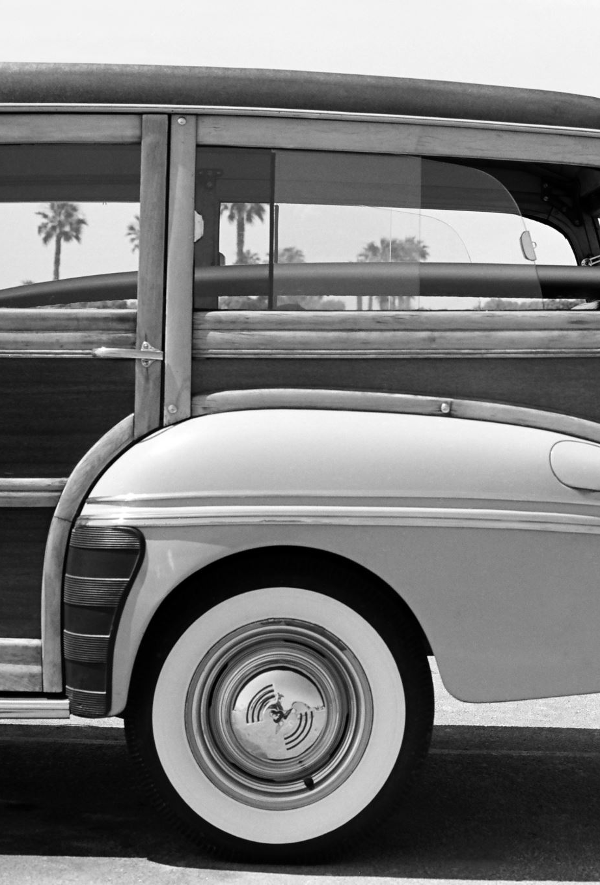
1955 Chevrolet safety features
Unpadded metal surfaces, blunt knobs and rods, steering columns that impale—and seatbelts weren’t even on the options list. We may think highly of the 1955 Chevrolet, but like all cars of the era, it didn’t think much of its passengers; here we use it as a lens through which to view the state of automobile safety of the time. Yes, 62 years later, things have become much safer.
A-Pillars: The ’55’s wraparound windshield was gorgeous. It also left the front of the roof supported by only thin pillars of Sheetmetal, ready to collapse under the car’s weight in a rollover. But just look at them.
Steering Column: Though the collapsible steering column was invented in the 1930s, GM didn’t begin installing them until 1967.
Steering-Wheel Hub: A bullet-nose cap at the centre of Chevy’s two- and three-spoke steering wheels all but guaranteed forehead-shattering or sternum-smashing injuries.
Dash: No squishy soft surfaces here. Only paint cushioned the blow from skull-crushing metal.

Slide 10
Classify each feature as either A, B, C, D according to the principle/s it is not employing, and which therefore makes it unsafe
Unpadded metal surfaces, blunt knobs and rods, steering columns that impale—and seatbelts weren’t even on the options list. We may think highly of the 1955 Chevrolet, but like all cars of the era, it didn’t think much of its passengers; here we use it as a lens through which to view the state of automobile safety of the time. Yes, 62 years later, things have become much safer.
A-Pillars: The ’55’s wraparound windshield was gorgeous. It also left the front of the roof supported by only thin pillars of Sheetmetal, ready to collapse under the car’s weight in a rollover. But just look at them.
Steering Column: Though the collapsible steering column was invented in the 1930s, GM didn’t begin installing them until 1967.
Steering-Wheel Hub: A bullet-nose cap at the centre of Chevy’s two- and three-spoke steering wheels all but guaranteed forehead-shattering or sternum-smashing injuries.
Dash: No squishy soft surfaces here. Only paint cushioned the blow from skull-crushing metal.

Slide 11
The role of safety in a car design
The best chances of surviving an accident are given by a solid structure, good restraint systems, and active safety support technologies. You might decide not to use one at all.

Slide 12
Improvements using principle of physics
For example, if a car is stationary and it is acted upon by an unbalanced force in a rear impact, it would move quickly forward. If a passenger is wearing a seatbelt, their torso is moved rapidly forward with the car, leaving their head behind and making it bend backwards quickly enough to cause injury.
Safety features such as seatbelts, airbags and crumple zones are now used in modern cars. Crumple zones change the shape of the car, which increases the time taken for the collision. These crumple zones are areas of a car that are designed to deform or crumple on impact.

